Slide 1
Photomicrographs of Plant foods
Leek
Permission to reproduce original photomicrographs used to make this collection may be obtained from
Dr. David O. Norris at
david.norris@colorado.edu

Slide 2
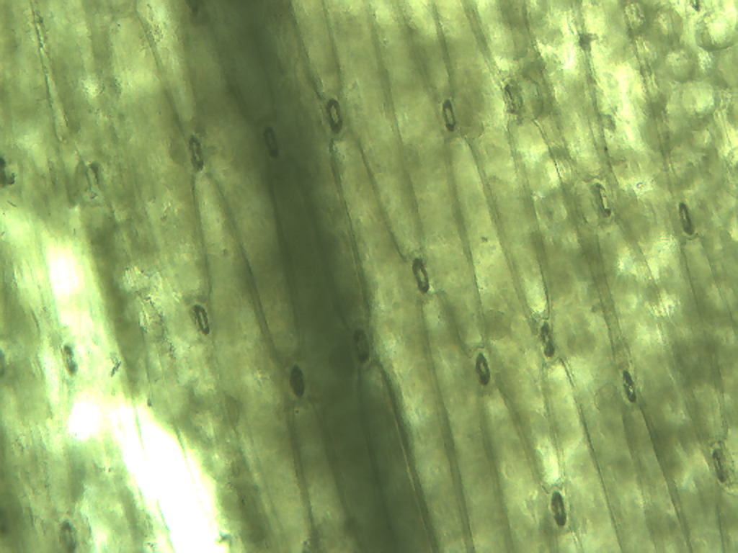
Notes:
265. Allium porrum L. Leek. Elongate outer epidermal cells; note stomata (arrows) 10X. Compare to chives.

Slide 3
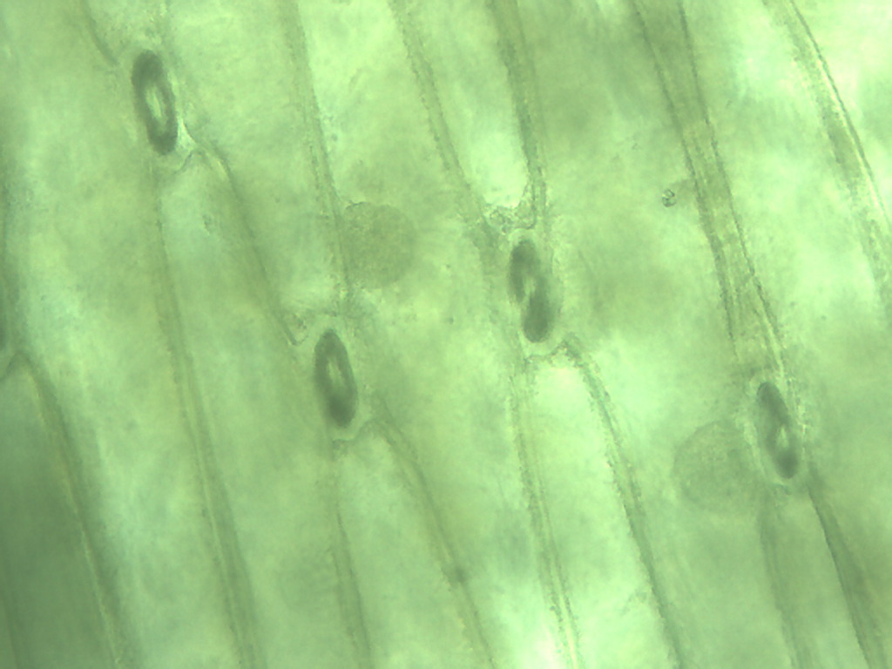
Notes:
266. Leek. Stomata (arrow) and epidermal cells, 25X

Slide 4
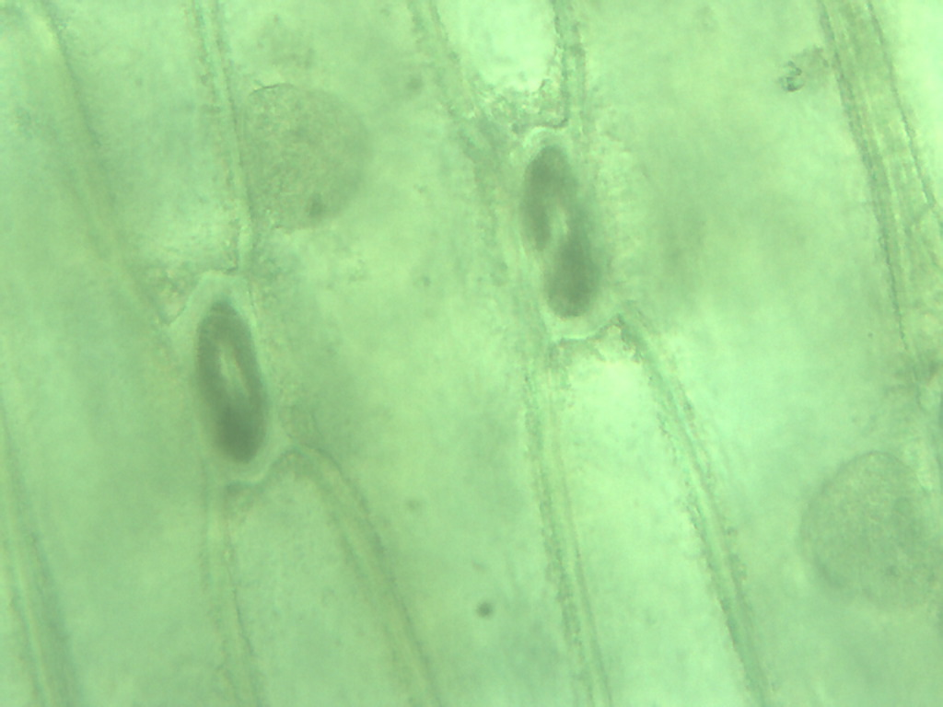
nucleus
nucleus
Notes:
267. Leek; elongate epidermal cells with stomatal complex (arrow) located between their ends, 40X. Compare to green onion (scallion) and chive.

Slide 5
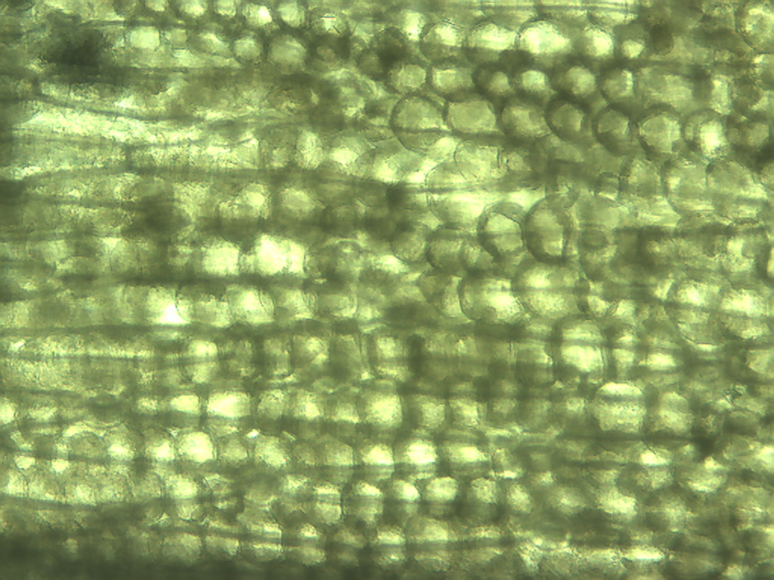
Notes:
268. Leek. Spherical photosynthetic parenchymal cells adhering to the elongate epidermal cells, 10X.

Slide 6
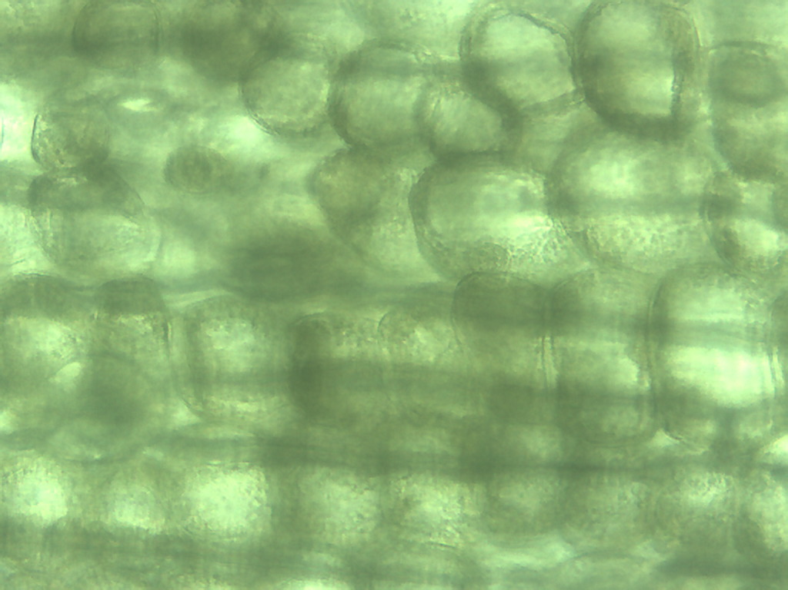
Notes:
269. Leek. Photosynthetic parenchymal cells, 25X

Slide 7
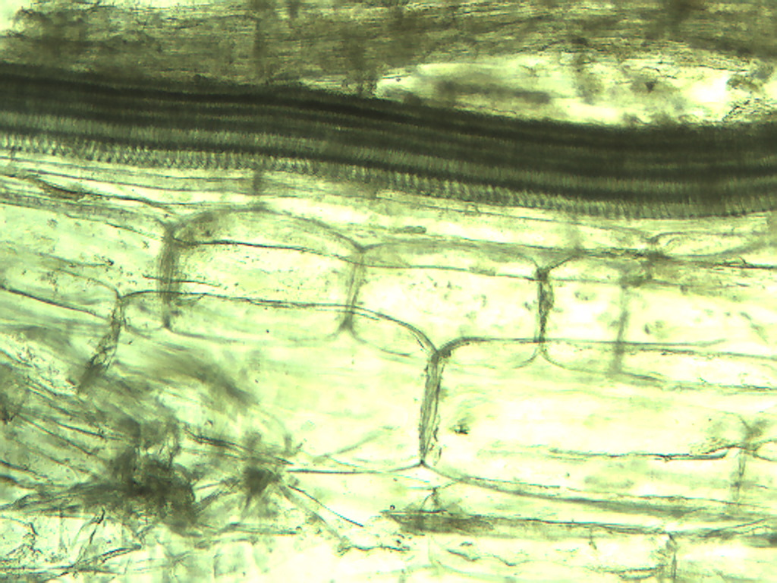
X
Notes:
270. Leek. Vascular tissue: vessels (arrow) and xylem (X), 10X.

Slide 8
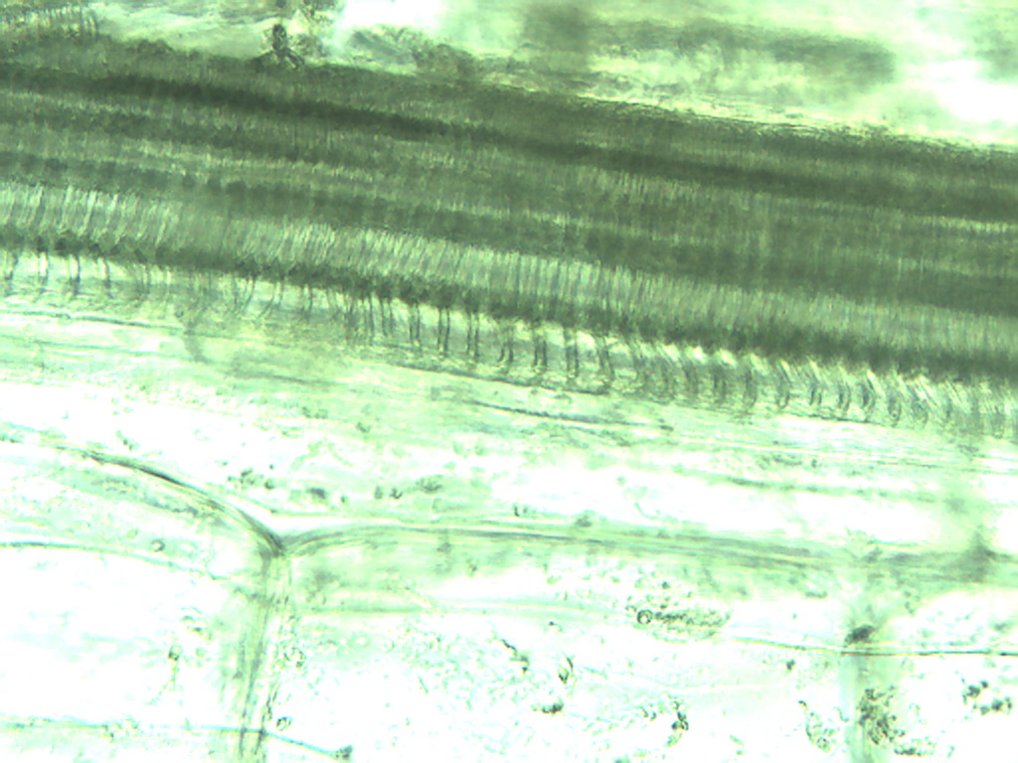
Notes:
271. Leek; vascular tissue and large parenchymal cells, 25X

Slide 9
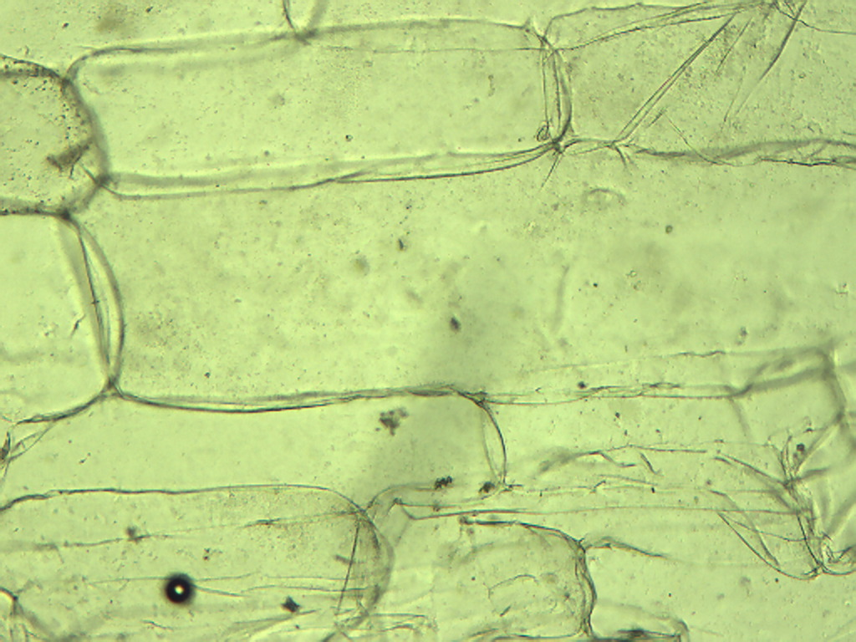
Notes:
272. Leek. Large rectangular parenchymal cells, 10X.

